Slide 1
Device Drivers
Higher National Diploma in Information Technology

Slide 2
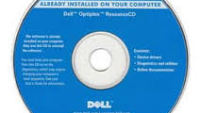
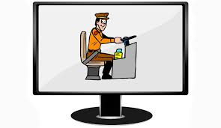
Device Drivers
A device driver is a computer program that operates or controls a particular type of device that is attached to a computer
Provide interface to Hardware devices

Slide 3
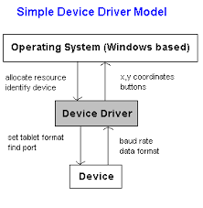
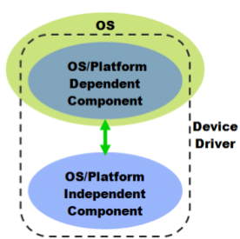
Drivers are hardware dependent
– Operating system specific
Calling program invokes a routine in the driver
– Driver issues commands to the device
Device sends data back to the driver
– driver may invoke routines in the calling program

Slide 4
How to get Drivers
Built into the product (Firmware)
Include with operating system (plug and play)
Comes with driver CD provided by vendor
Download from internet or vendor web site
• Important
– After installing some device drivers computer may
need to restart
• To read the device drivers in to primary memory

Slide 5
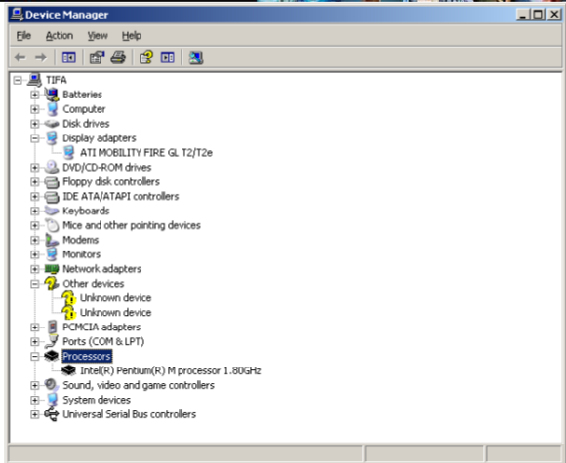
Device Manager
Change hardware configuration settings.
Obtain information about each device driver.
Install & updated device drivers.
Disable, enable, and uninstall devices.
Reinstall the previous version of a driver.
Identify device conflicts and manually configure resource settings.
• Print a summary of the devices that are installed on your computer.

Slide 6
How to get Device Manager
Windows XP
– Control panel -> System-> hardware tab - Device
Manager
• Windows Vista
– Control Panel -> Device Manager
• Windows 7
– Control Panel -> Device Manager

Slide 7
Plug and Play
Also known as hot plugging/ hot swapping
• Technology to automatically detect the attached HW in a computer system with
minimum user intervention
– Automatically detection is a capability of a computer bus
– It facilitates the discovery of a hardware in a
System
Plug and Play devices:
• PS2 mouse or key board
• All USB devices

